Slide 1
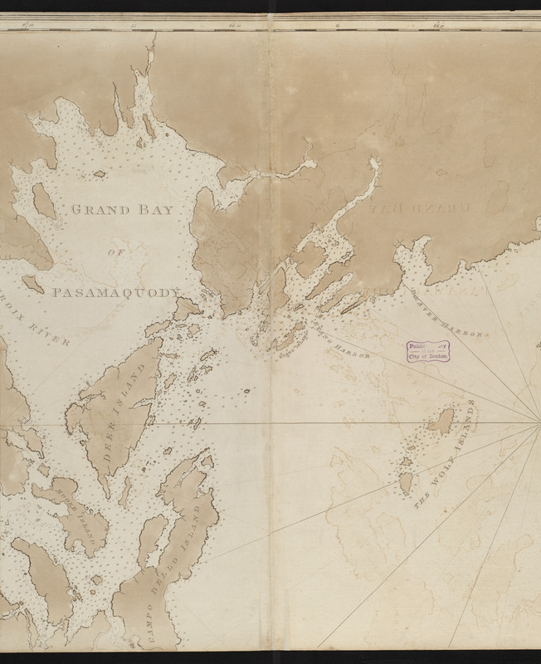
Preserving The coastal waters of the Wabanaki people: A workplan for coastal resilience
Presented By: Devon Newell (Project Manager) and Sam Gilbert (Assistant Manager)

Slide 2
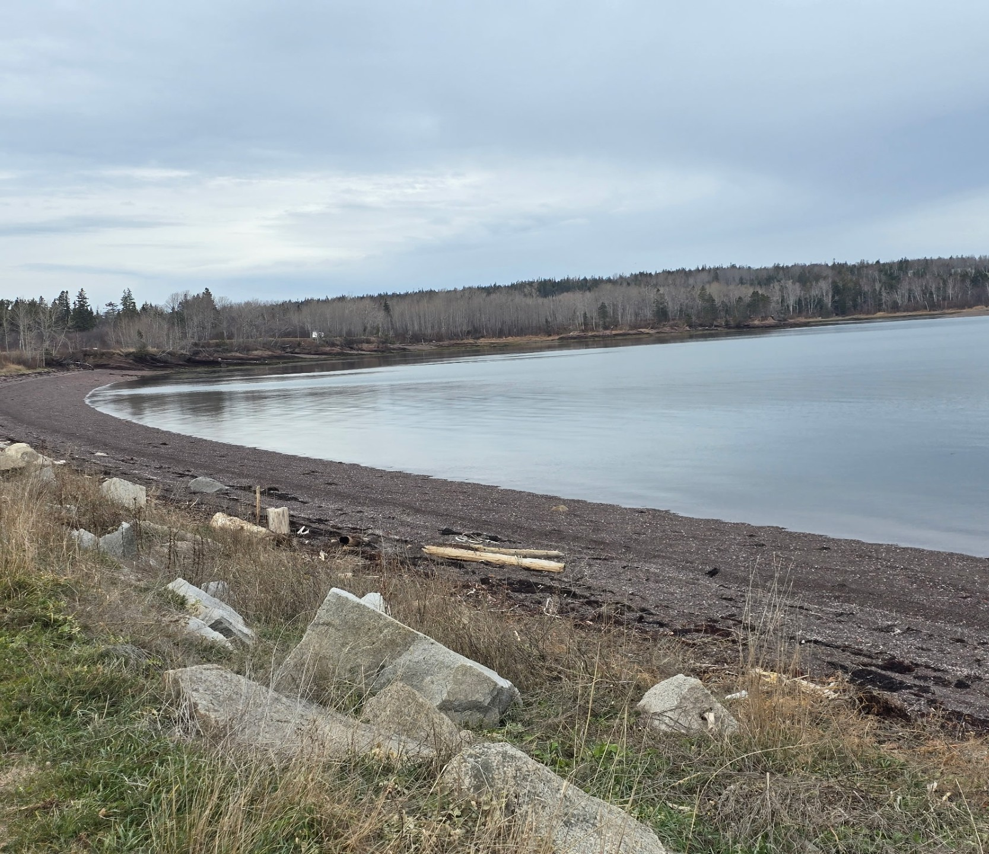
Why Our Shores Are Under Pressure
Erosion and Storm Surges – Increased storm frequency and intensity accelerate shoreline erosion, threatening habitats and infrastructure.
Invasive Species – European green crabs disrupt native ecosystems by preying on shellfish and uprooting eelgrass beds.
Loss of Eelgrass Beds – These critical nurseries for marine life are disappearing, reducing habitat for fish and invertebrates.
Ocean Acidification – Weakens shellfish shells and alters marine food webs, impacting fisheries and biodiversity.
Cumulative Threats – Combined pressures from climate change, habitat loss, and species imbalance undermine coastal resilience.

Slide 3
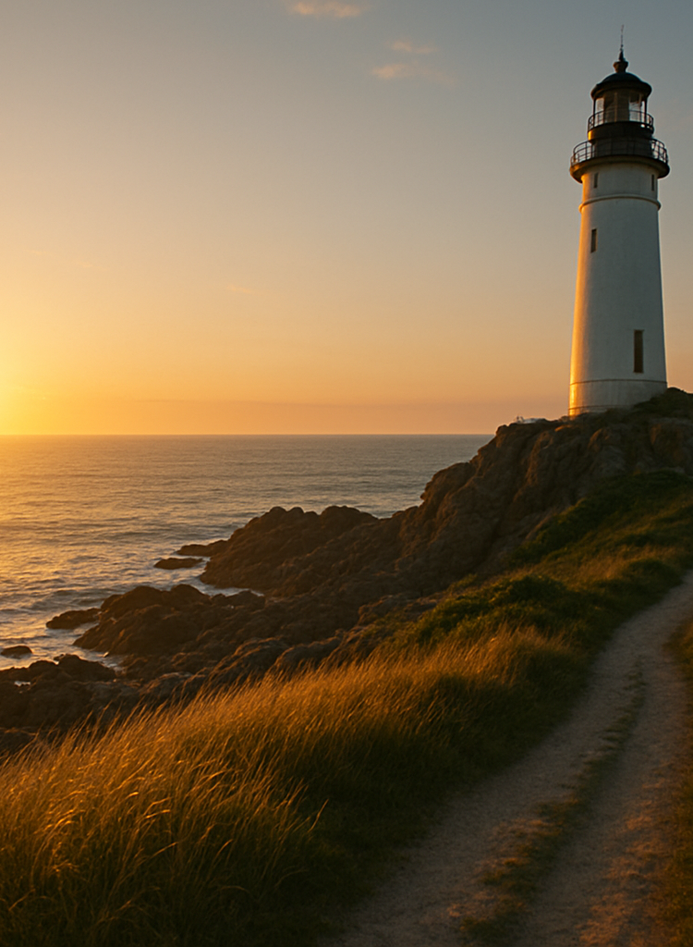
Our vision
Healthy, resilient coastlines
Restored eelgrass beds for nurturing marine life
Hazard preparedness for tribal communities
Mitigating green crab impacts
Ocean health safeguard
“We envision thriving eelgrass nurseries, resilient shellfish, and coastlines that protect both people and ecosystems.”

Slide 4
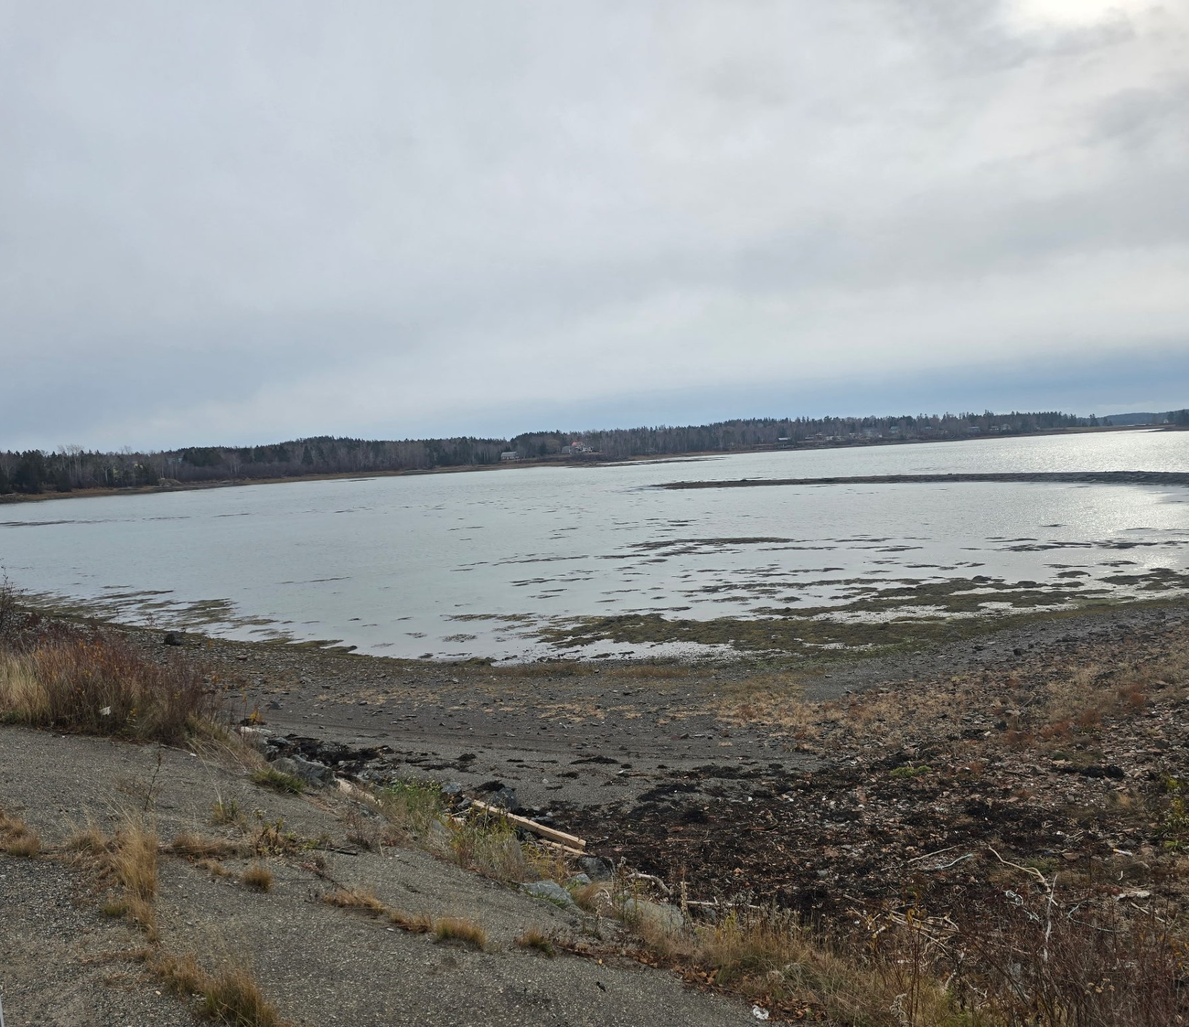
Why This Work Matters
Protects Cultural and Ecological heritage
Strengthens food security and fisheries
Builds climate resilience
Empowers Tribal Stewardship
Blue Carbon Sequestration – Eelgrass beds capture CO₂.
“Restoring eelgrass beds means restoring nurseries of our shorelines. They also act as powerful carbon sinks, storing ‘blue carbon’ and helping fight climate change.”

Slide 5

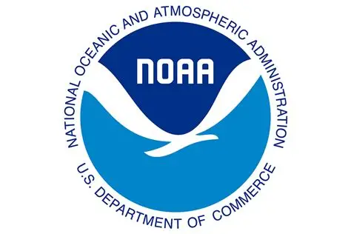
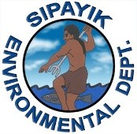
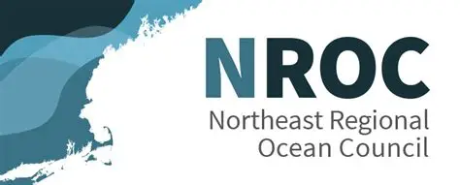
The Workplan
Research and Understanding of Coastal and Ocean Resources
Resilience Projects: eelgrass restoration and shoreline protection
Living Shorelines: Use soft engineering for erosion control and habitat sanctuaries.
Community-Led Green Crab Control
Partnerships: Collaborate with NOAA, NROC, and the Passamaquoddy Tribe

Slide 6
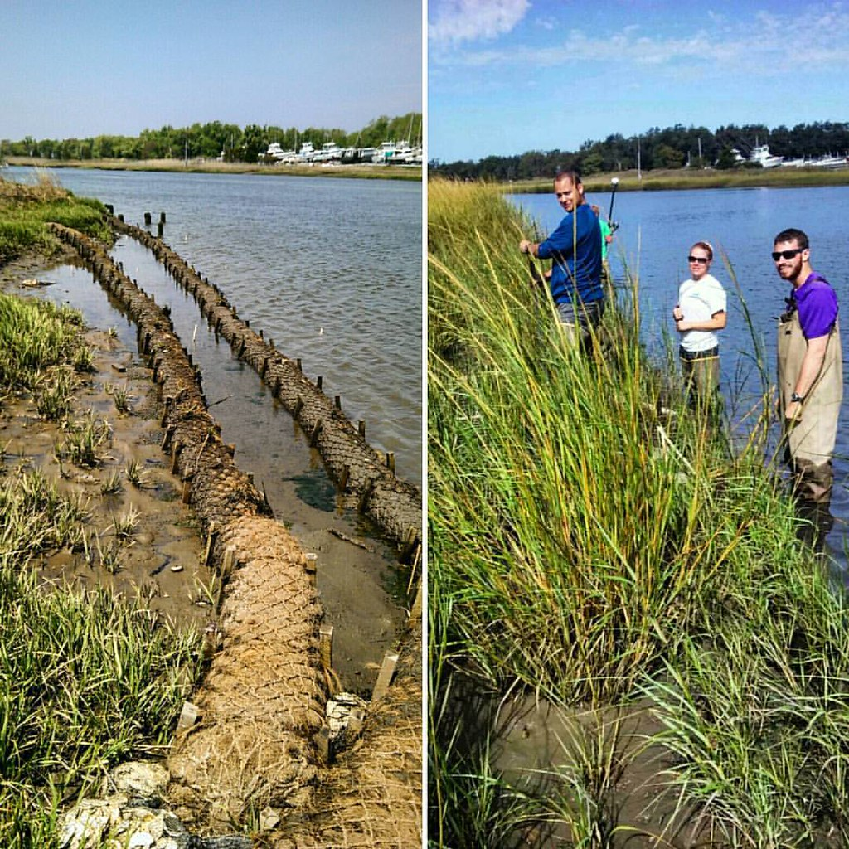
Year 1- Building foundations
Q1: Launch data collection, assess acidification, and survey eelgrass.
Q2: Policy advocacy, monitoring systems, stakeholder engagement.
Q3: Education programs, pilot living shorelines, eelgrass restoration.
Q4: Outreach campaigns, training, secure funding partnerships.

Slide 7
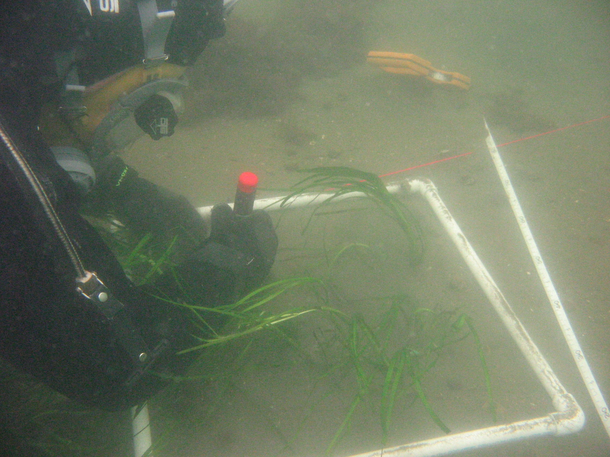
Year 2 – Scaling & Sustaining
Continue
Q1: Continue monitoring, track restoration, publish interim findings.
Advance
Q2: Advance advocacy with data, refine evaluation, secure funding.
Expand
Q3: Expand education, scale resource management, add shoreline sanctuaries.
Share
Q4: Share success stories, consolidate stewardship, present 2-year report.

Slide 8
What is a Living Shoreline
Definition:
Nature-based approach to stabilize coastlines using plants, sand, and sometimes rock structures instead of hard seawalls.
Key Features: Combines soft engineering with natural habitats.
Uses native vegetation, oyster reefs, and biodegradable materials.
Benefits:
Reduces erosion while maintaining natural shoreline processes.
Provides habitat for fish, shellfish, and birds.
Improves water quality and supports blue carbon storage.
Enhances resilience against storm surges and flooding.

Slide 9
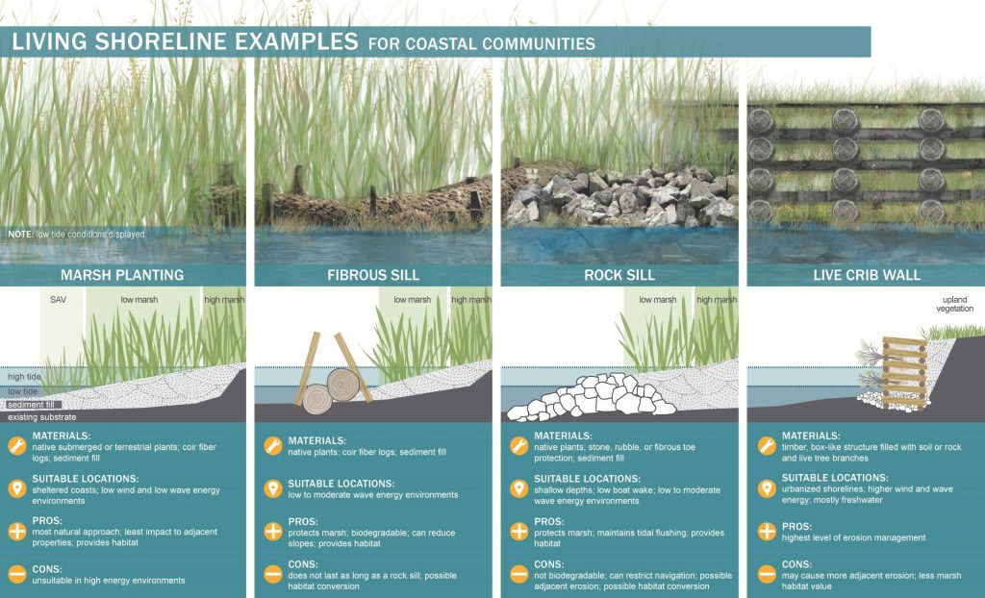
This Photo by Unknown Author is licensed under CC BY-NC-ND

Slide 10
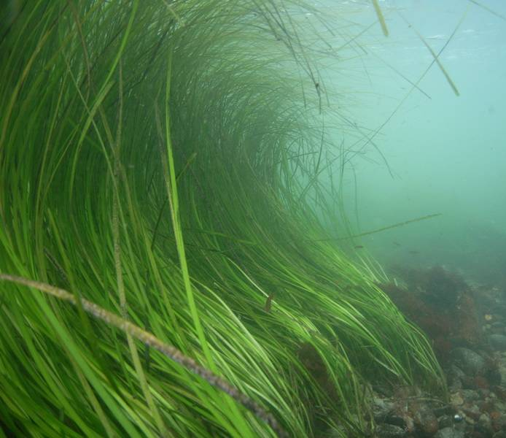
What is Eelgrass?
Forms underwater meadows anchored by roots and rhizomes in sandy or muddy sea beds.
Provides habitat and shelter for fish, shellfish, and invertebrates.
Improves water quality, stabilizes sediments, and stores blue carbon (helps fight climate change).
(Source: NOAA Fisheries, Audubon, WBUR)

Slide 11
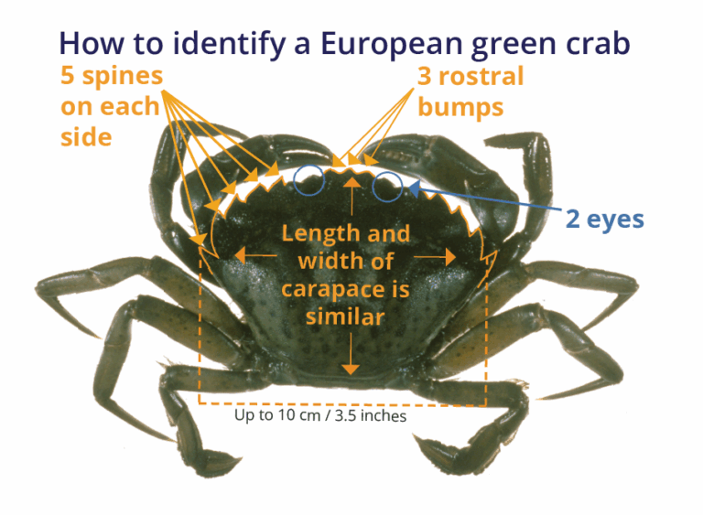
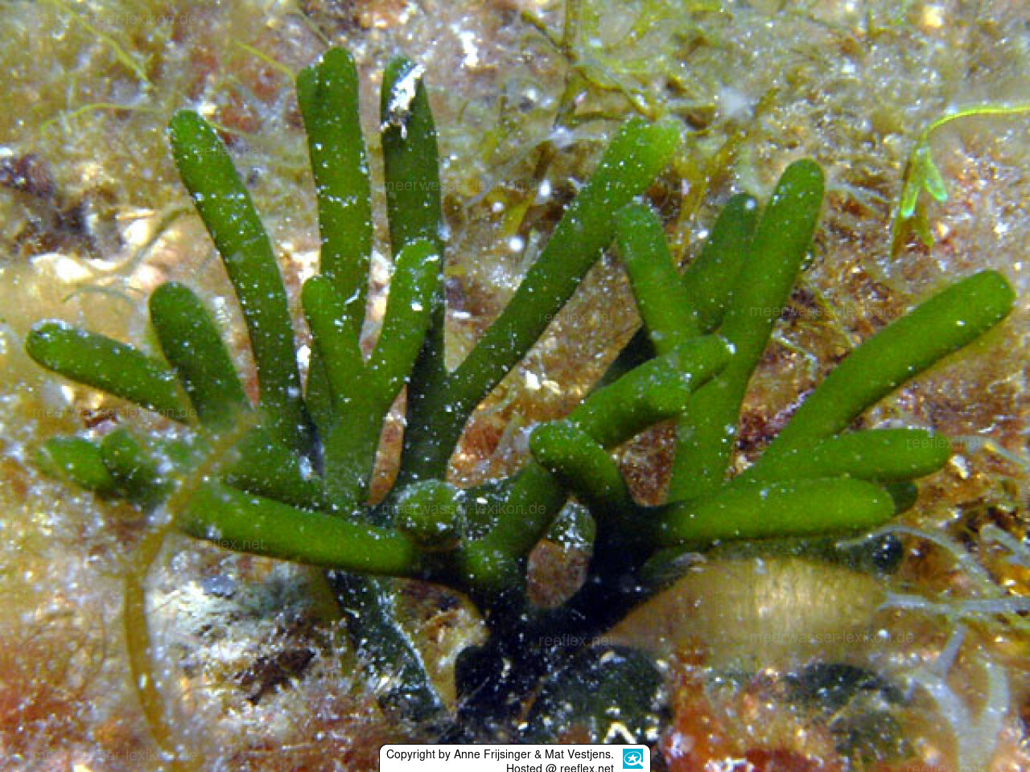
Invasive Species & Native Species at Risk
Invasive Species (Maine Gulf Coast):
European Green Crab – uproots eelgrass, preys on clams.
Asian Shore Crab – competes with native crabs.
Codium fragile – invasive algae smothering shellfish beds.
Dasysiphonia japonica – dense algal mats altering habitats.
Didemnum vexillum – colonial tunicate smothering seafloor.
Membranipora membranacea – fouls kelp and eelgrass blades.
Native Species at Risk:
Finfish: Atlantic herring, Juvenile cod, Winter flounder.
Shellfish: Soft-shell clam, Bay scallop, American lobster.
Birds: Atlantic brant, American black duck.
Other: Eastern oyster, Epiphytic organisms.

Slide 12
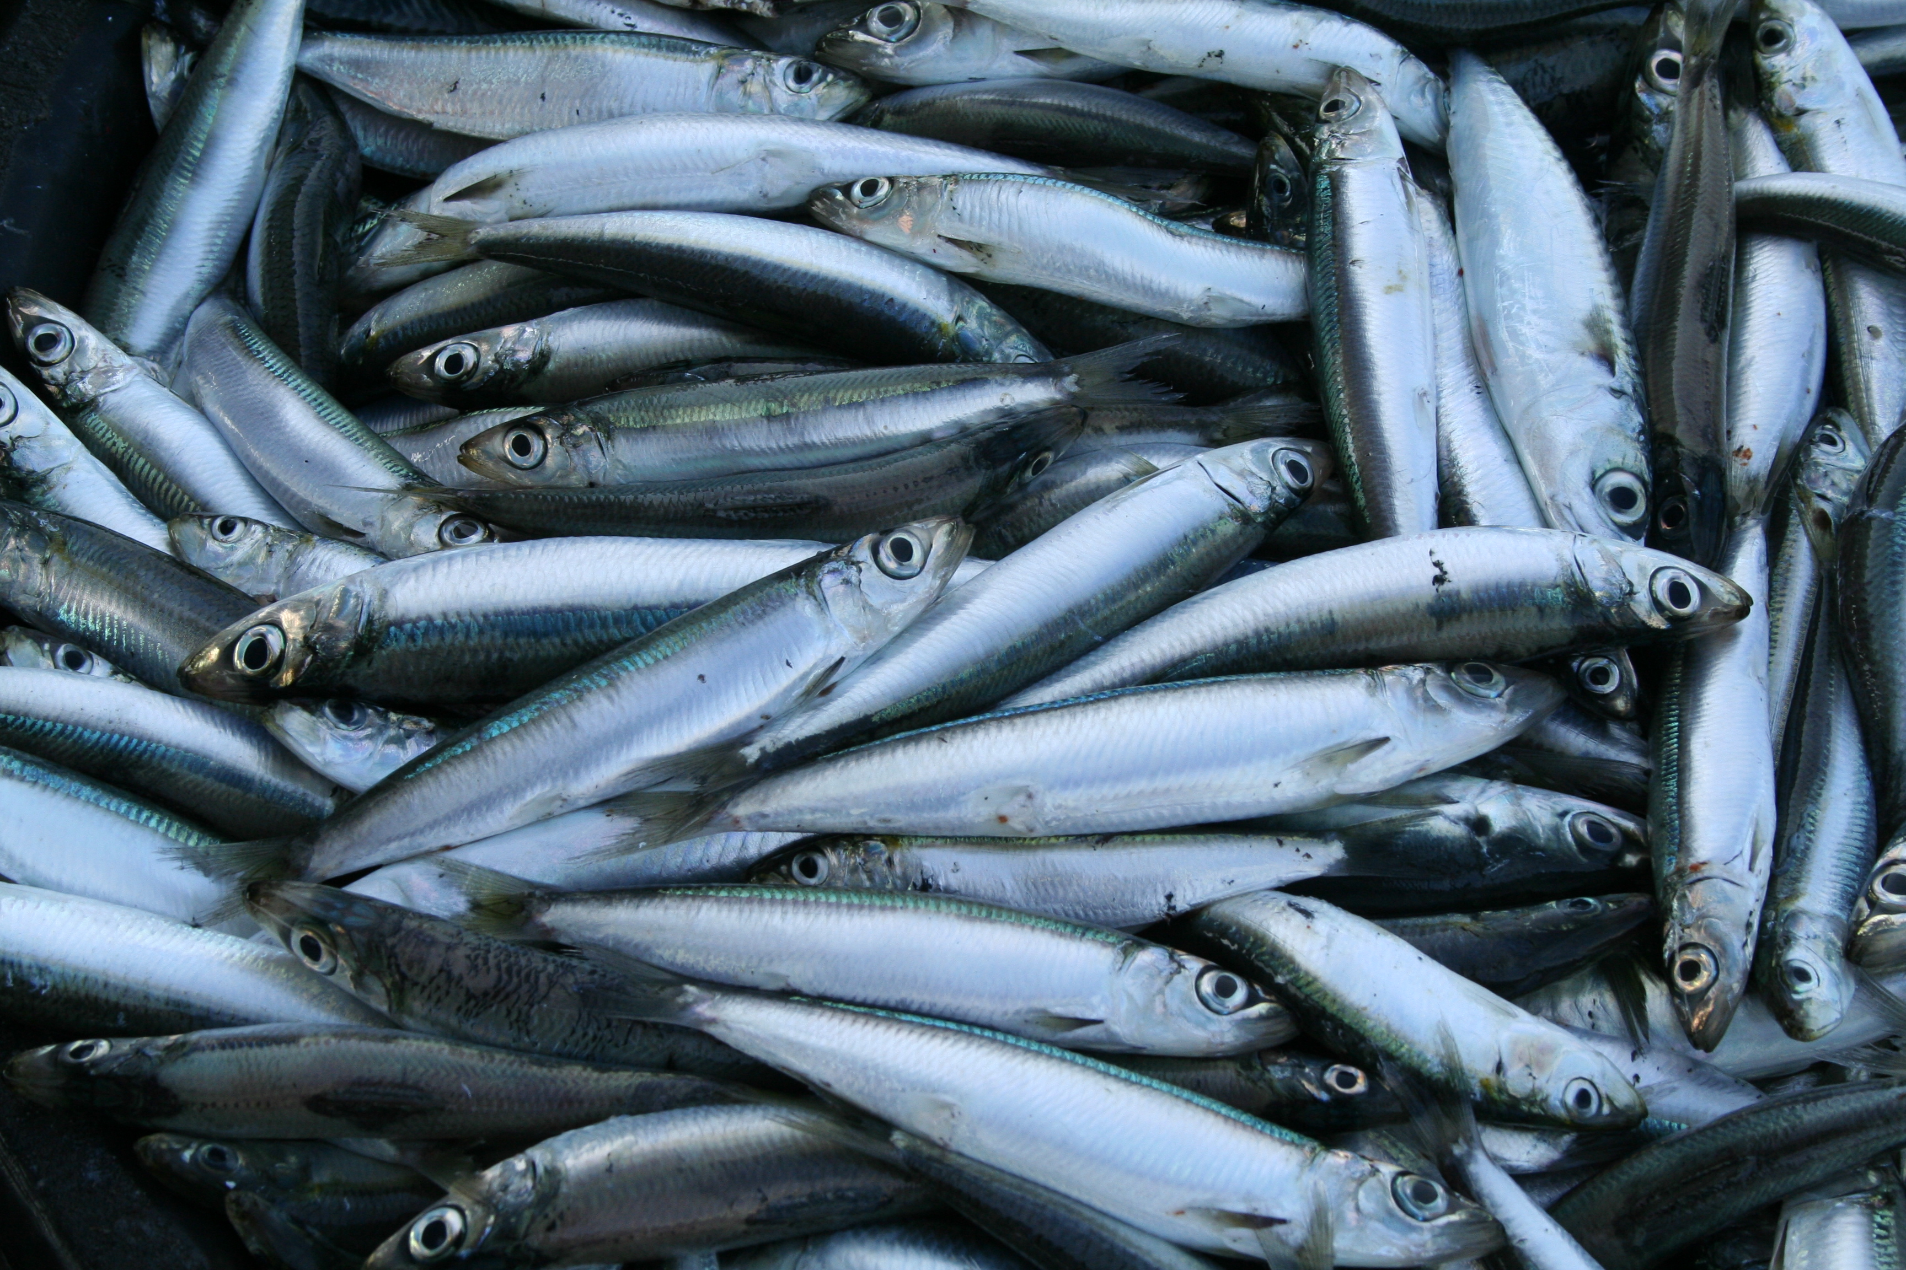
Fin Fish affected by Eelgrass bed loss
Atlantic herring (Clupea harengus) – uses eelgrass for spawning surfaces.
Juvenile cod (Gadus morhua) – relies on eelgrass for shelter and feeding.
Winter flounder (Pseudopleuronectes americanus) – nursery habitat in eelgrass beds.
Bay pipefish (Syngnathus fuscus) – highly dependent on eelgrass structure.
Shiner perch (Cymatogaster aggregata) – habitat specialist in eelgrass zones.
Tomcod (Microgadus tomcod) – juveniles shelter in eelgrass beds in estuaries.

Slide 13
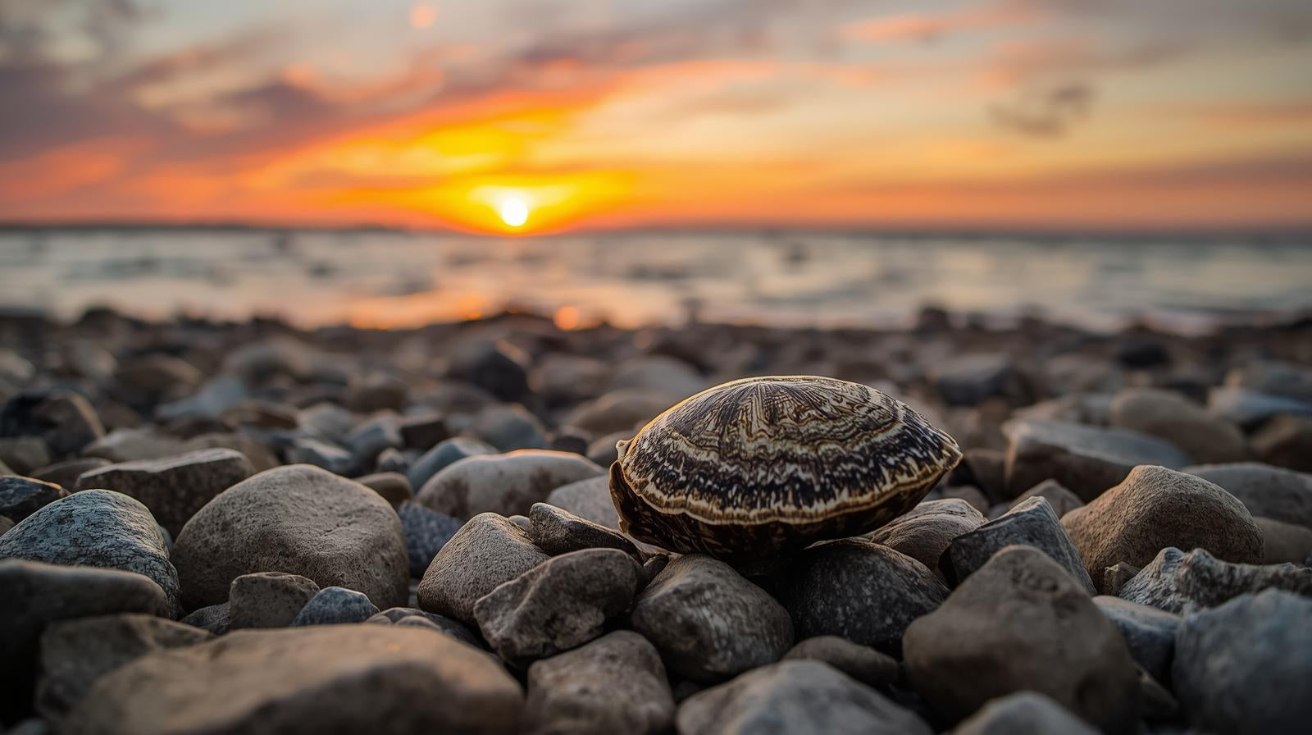
Shellfish affected by eelgrass loss
Blue mussel (Mytilus edulis) – benefits from sediment stabilization and food availability.
Soft-shell clam (Mya arenaria) – vulnerable to green crab predation and habitat loss.
Bay scallop (Argopecten irradians) – attaches to eelgrass blades during juvenile stages.
American lobster (Homarus americanus) – juveniles use eelgrass for shelter and foraging.

Slide 14
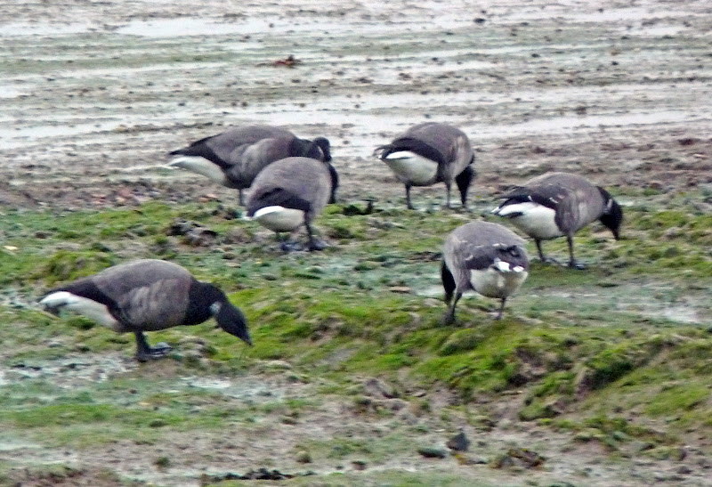
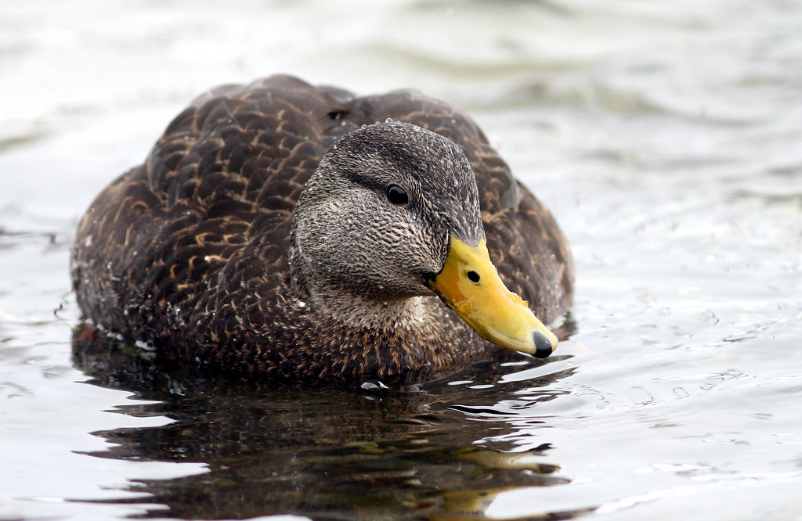
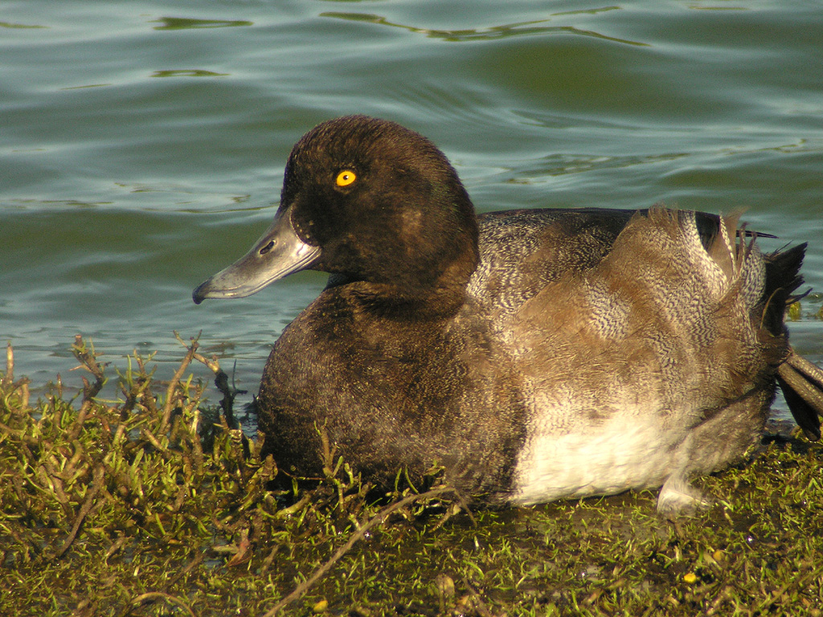
Birds affected by eelgrass bed loss
Atlantic brant (Branta bernicla) – feeds primarily on eelgrass leaves during migration and winter.
American black duck (Anas rubripes) – forages in eelgrass meadows for invertebrates.
Greater scaup (Aythya marila) – feeds in eelgrass beds on mollusks and vegetation.

Slide 15
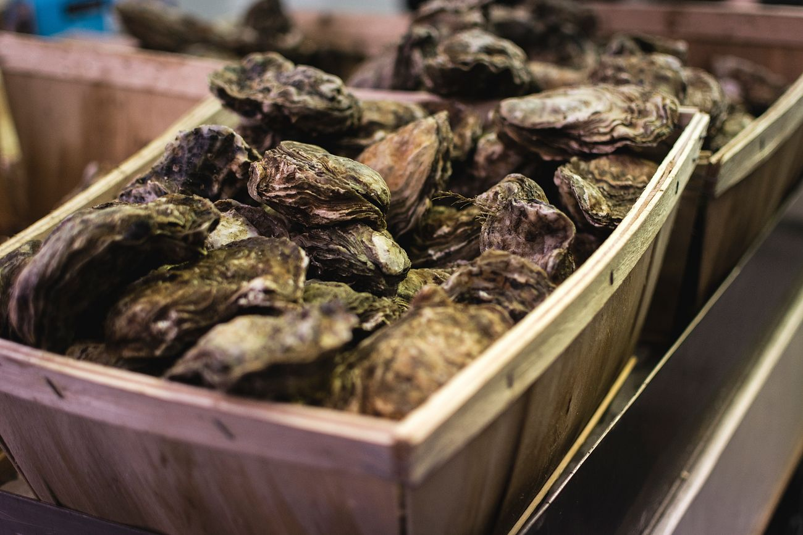
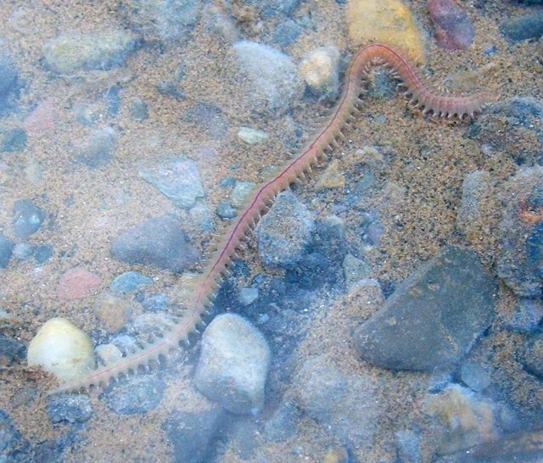
Other species affected
Eastern oyster (Crassostrea virginica) – juveniles settle on eelgrass blades for early development.
Epiphytic organisms (amphipods, isopods, polychaete worms) – live on eelgrass blades and form a key part of the food web.
This Photo by Unknown Author is licensed under CC BY-SA

Slide 16
Why these species are affected
Loss of nursery habitats for juvenile fish and shellfish.
Reduced food availability for grazers and filter feeders.
Increased predation risk due to lack of shelter.
Disruption of spawning grounds for species like herring.

Slide 17
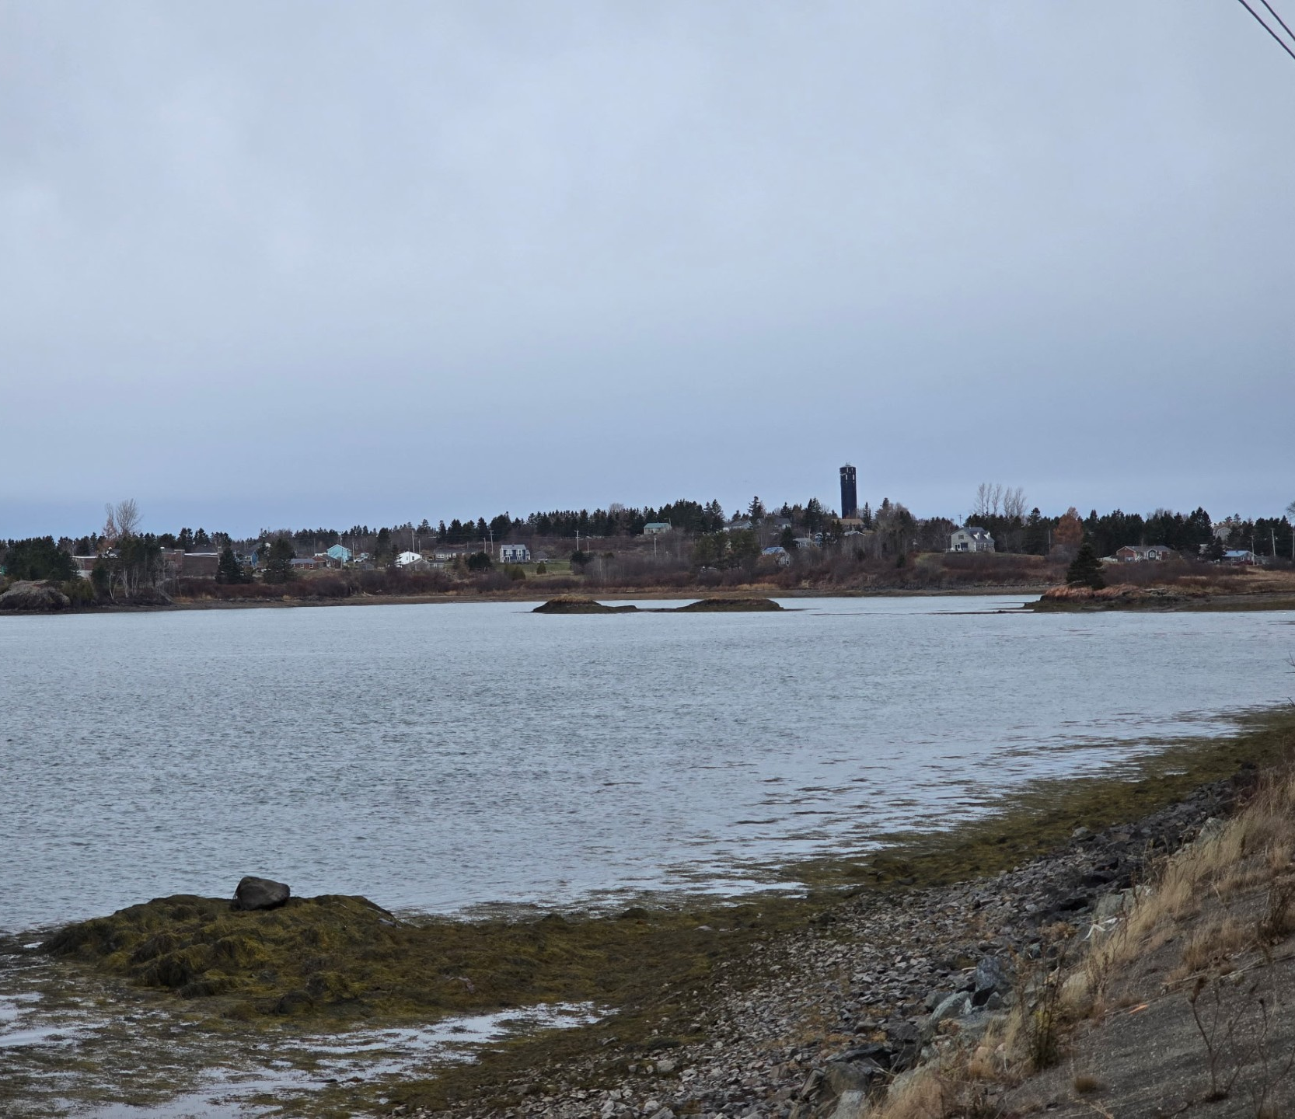
Our Strategy
Community Action – Green crab trapping programs.
Habitat Restoration – Replant eelgrass beds.
Policy Advocacy – Support protective regulations.
Monitoring & Detection – Citizen science programs.
Education & Outreach – Raise awareness locally.

Slide 18
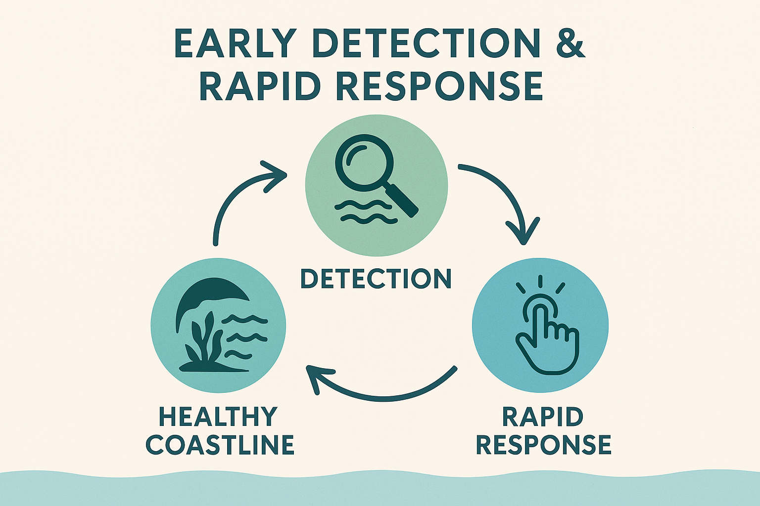
Early Detection & Rapid Response
What We Do:
Use DNA sampling and shoreline surveys to spot invasive species early.
Why It Matters:
Quick action prevents damage to eelgrass beds and fisheries.
Your Role:
Join citizen science programs—every observation counts!

Slide 19
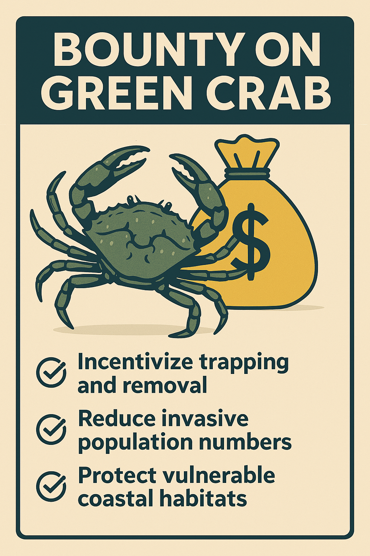
Intensive Trapping Programs
Method: Deploy traps (e.g., Fukui traps) in infested areas to physically remove crabs.
Effectiveness: Studies show trapping can reduce local populations and alter demographics (smaller size, fewer females)
Does not achieve long-term eradication due to high recruitment rates. It works best as a localized control measure.
Best Practices:
  Use multiple trap types to maximize catch.
  Target peak activity seasons (spring and summer).
  Coordinate trapping with monitoring to adapt strategies.
  Source: DFO Science Advisory Report on trapping methods; Study on depletion trapping. [publications.gc.ca] [reabic.net]

Slide 20
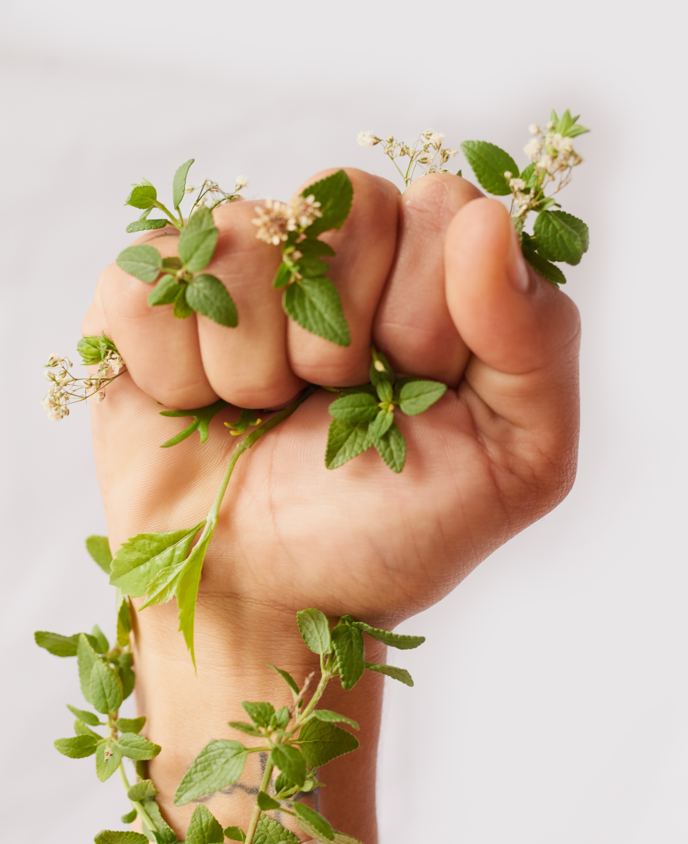
Call to action
Support is needed to launch and sustain our goals
Investment leads to measurable ecological and community benefits
Opportunity for community outreach—empowering locals to participate in stewardship that creates global impact.

Slide 21
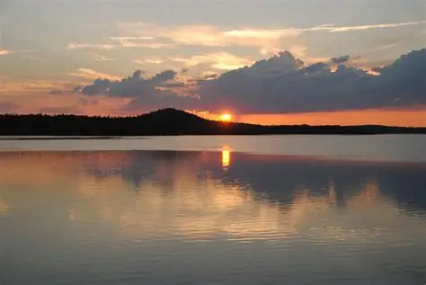
Thank you
Devon Newell (Project manager)
devonnewell@wabanaki.com
(207) 853-5147
Sam Gilbert (Assistant Manager)
samtomah@wabanaki.com
(207) 853-5148

